Slide 1
Cooperating Intelligent Systems
Adversarial search
Chapter 6, AIMA 2nd ed
Chapter 5, AIMA 3rd ed
This presentation owes a lot to V. Pavlovic @ Rutgers, who borrowed from J. D. Skrentny, who in turn borrowed from C. Dyer,...

Slide 2
Adversarial search
At least two agents and a competitive environment: Games, economies.
Games and AI:
  Generally considered to require intelligence (to win)
  Have to evolve in real-time
  Well-defined and limited environment

Slide 3
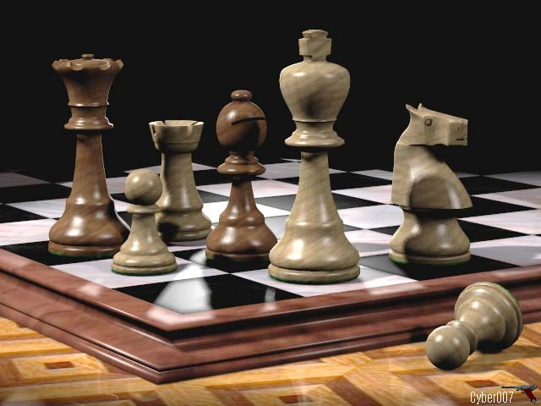
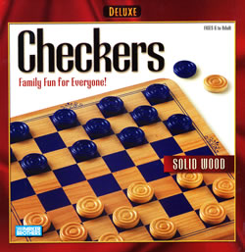

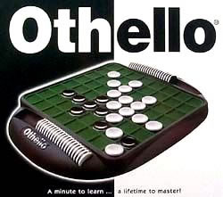
Board games
© Thierry Dichtenmuller

Slide 4
Games & AI
 | Deterministic | Chance
perfect info | Checkers, Chess, Go, Othello | Backgammon, Monopoly
imperfect info |  | Bridge, Poker, Scrabble

Slide 5
Games and search
Traditional search: single agent, searches for its well-being, unobstructed
Games: search against an opponent
Example: two player board game (chess, checkers, tic-tac-toe,…)
  Board configuration: unique arrangement of "pieces“
Representing board games as goal-directed search problem (states = board configurations):
  Initial state: Current board configuration
  Successor function: Legal moves
  Goal state: Winning/terminal board configuration
  Utility function: Value of final state

Slide 6
Example: Tic-tac-toe
Initial state: 3×3 empty table.
Successor function: Players take turns marking  or  in the table cells.
Goal state: When all the table cells are filled or when either player has three symbols in a row.
Utility function: +1 for three in a row, -1 if the opponent has three in a row, 0 if the table is filled and no-one has three symbols in a row.
Initial state

 | 
 |  | 
 |  | 
 |  | 
 |  | 
 | 

 | 
 |  | 
 |  | 


 | 
 | 
 |  | 

 | 

 | 
 |  | 

 |  | 


 |  | 
 |  | 
 |  | 
Goal state
Utility = 0

 | 

 |  | 
Goal state
Utility = +1
Goal state
Utility = -1

Slide 7
The minimax principle
Assume the opponent plays to win and always makes the best possible move.
The minimax value for a node = the utility for you of being in that state, assuming that both players (you and the opponent) play optimally from there on to the end.
Terminology:
MAX = you, MIN = the opponent.

Slide 8
Example: Tic-tac-toe
 |  | 
 |  | 
 | 
Your (MAX) move
()
Assignment: Expand this tree to the end of the game.

Slide 9
Example: Tic-tac-toe
 |  | 
 |  | 
 | 
Your (MAX) move
Opponent
(MIN) move
 |  | 
 |  | 
 | 
 |  | 
 |  | 
 | 
 |  | 
 |  | 
 |  | 
Your
(MAX)
move
 |  | 
 |  | 
 | 
 |  | 
 |  | 
 |  | 
 |  | 
 |  | 
 | 
 |  | 
 |  | 
 |  | 
 |  | 
 |  | 
 |  | 
 |  | 
 |  | 
 |  | 
 |  | 
 |  | 
 |  | 
 |  | 
 |  | 
 |  | 
 |  | 
 |  | 
 |  | 
 |  | 
 |  | 
 |  | 
 |  | 
 |  | 
 |  | 
 |  | 
 |  | 
 |  | 
Utility = +1
Utility = 0
Utility = 0
Utility = 0
Utility = 0
Utility = +1

Slide 10
Example: Tic-tac-toe
 |  | 
 |  | 
 | 
Your (MAX) move
Opponent
(MIN) move
 |  | 
 |  | 
 | 
 |  | 
 |  | 
 | 
 |  | 
 |  | 
 |  | 
Your
(MAX)
move
 |  | 
 |  | 
 | 
 |  | 
 |  | 
 |  | 
 |  | 
 |  | 
 | 
 |  | 
 |  | 
 |  | 
 |  | 
 |  | 
 |  | 
 |  | 
 |  | 
 |  | 
Minimax
value
+1
0
0
0
0
+1
 |  | 
 |  | 
 |  | 
 |  | 
 |  | 
 |  | 
 |  | 
 |  | 
 |  | 
 |  | 
 |  | 
 |  | 
 |  | 
 |  | 
 |  | 
 |  | 
 |  | 
 |  | 
Utility = +1
Utility = 0
Utility = 0
Utility = 0
Utility = 0
Utility = +1

Slide 11
Example: Tic-tac-toe
 |  | 
 |  | 
 | 
Your (MAX) move
Opponent
(MIN) move
 |  | 
 |  | 
 | 
 |  | 
 |  | 
 | 
 |  | 
 |  | 
 |  | 
Minimax
value
0
0
0
Your
(MAX)
move
 |  | 
 |  | 
 | 
 |  | 
 |  | 
 |  | 
 |  | 
 |  | 
 | 
 |  | 
 |  | 
 |  | 
 |  | 
 |  | 
 |  | 
 |  | 
 |  | 
 |  | 
Minimax
value
+1
0
0
0
0
+1
 |  | 
 |  | 
 |  | 
 |  | 
 |  | 
 |  | 
 |  | 
 |  | 
 |  | 
 |  | 
 |  | 
 |  | 
 |  | 
 |  | 
 |  | 
 |  | 
 |  | 
 |  | 
Utility = +1
Utility = 0
Utility = 0
Utility = 0
Utility = 0
Utility = +1

Slide 12
Example: Tic-tac-toe
 |  | 
 |  | 
 | 
Your (MAX) move
Minimax
value
0
Opponent
(MIN) move
 |  | 
 |  | 
 | 
 |  | 
 |  | 
 | 
 |  | 
 |  | 
 |  | 
Minimax
value
0
0
0
Your
(MAX)
move
 |  | 
 |  | 
 | 
 |  | 
 |  | 
 |  | 
 |  | 
 |  | 
 | 
 |  | 
 |  | 
 |  | 
 |  | 
 |  | 
 |  | 
 |  | 
 |  | 
 |  | 
Minimax
value
+1
0
0
0
0
+1
 |  | 
 |  | 
 |  | 
 |  | 
 |  | 
 |  | 
 |  | 
 |  | 
 |  | 
 |  | 
 |  | 
 |  | 
 |  | 
 |  | 
 |  | 
 |  | 
 |  | 
 |  | 
Utility = +1
Utility = 0
Utility = 0
Utility = 0
Utility = 0
Utility = +1

Slide 13
The minimax value
Minimax value for node n =
Utility(n) | If n is a terminal node
Max(Minimax-values of successors) | If n is a MAX node
Min(Minimax-values of successors) | If n is a MIN node
High utility favours you (MAX), therefore choose move with highest utility
Low utility favours the opponent (MIN), therefore choose move with
lowest utility

Slide 14
The minimax algorithm
Start with utilities of terminal nodes
Propagate them back to root node by choosing the minimax strategy
A
A
A
A
1
A
A
max
B
B
-5
B
B
-5
B
B
C
C
-6
C
C
-6
C
C
D
D
0
D
D
0
D
D
E
E
1
E
E
1
E
E
min
F
-7
F
7
F
-7
G
-5
G
-5
G
-5
H
3
H
3
H
3
I
9
I
9
I
9
J
-6
J
-6
J
-6
K
0
K
0
K
0
L
2
L
2
L
2
M
1
M
1
M
1
N
3
N
3
N
3
O
2
O
2
O
2
Figure borrowed from V. Pavlovic

Slide 15
The minimax algorithm
Start with utilities of terminal nodes
Propagate them back to root node by choosing the minimax strategy
A
A
A
A
1
A
A
max
B
B
-5
B
B
-5
B
B
C
C
-6
C
C
-6
C
C
D
D
0
D
D
0
D
D
E
E
1
E
E
1
E
E
min
F
-7
F
7
F
-7
G
-5
G
-5
G
-5
H
3
H
3
H
3
I
9
I
9
I
9
J
-6
J
-6
J
-6
K
0
K
0
K
0
L
2
L
2
L
2
M
1
M
1
M
1
N
3
N
3
N
3
O
2
O
2
O
2
Figure borrowed from V. Pavlovic

Slide 16
The minimax algorithm
Start with utilities of terminal nodes
Propagate them back to root node by choosing the minimax strategy
A
A
A
A
1
A
A
max
B
B
-5
B
B
-5
B
B
C
C
-6
C
C
-6
C
C
D
D
0
D
D
0
D
D
E
E
1
E
E
1
E
E
min
F
-7
F
7
F
-7
G
-5
G
-5
G
-5
H
3
H
3
H
3
I
9
I
9
I
9
J
-6
J
-6
J
-6
K
0
K
0
K
0
L
2
L
2
L
2
M
1
M
1
M
1
N
3
N
3
N
3
O
2
O
2
O
2
Figure borrowed from V. Pavlovic

Slide 17
Complexity of minimax algorithm
A depth-first search
  Time complexity O(b^{d})
  Space complexity O(bd)
Time complexity impossible in real games (with time constraints) except in very simple games (e.g. tic-tac-toe)

Slide 18
Strategies to improve minimax
Remove redundant search paths
- symmetries
Remove uninteresting search paths
- alpha-beta pruning
Cut the search short before goal
- Evaluation functions
Book moves

Slide 19
1. Remove redundant paths
Tic-tac-toe has mirror symmetries
and rotational symmetries
 |  | 

 |  | 
 |  | 
 | 
 | 


 | 
 |  | 
 |  | 
=
=
=

Slide 20
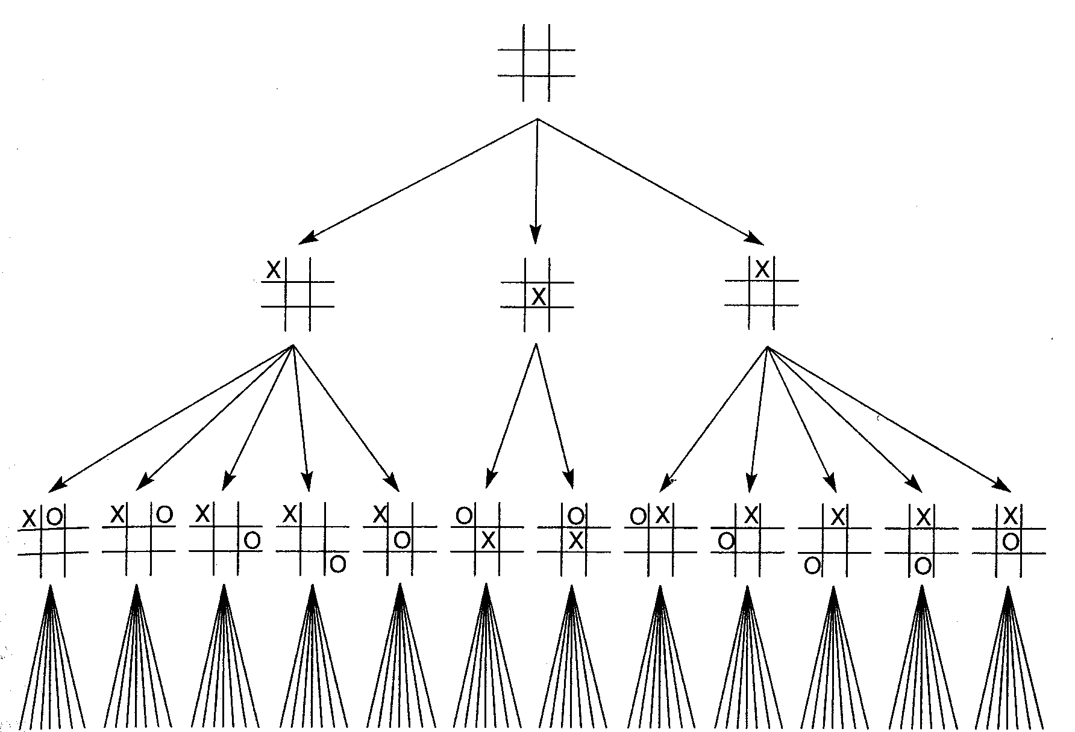
First three levels of the tic-tac-toe state space reduced by symmetry
3 states
(instead of 9)
12 states
(instead of
8·9 = 72)
Image from G. F. Luger, ”Artificial Intelligence”, 2002

Slide 21
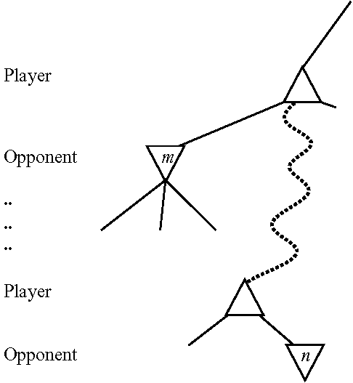
2. Remove uninteresting paths
If the player has a better choice m at n’s parent node, or at any node further up, then node n will never be reached.
Prune the entire path below node m’s parent node (except for the path that m belongs to, and paths that are equal to this path).
Minimax is depth-first → keep track of highest (α) and lowest (β) values so far.
Called alpha-beta pruning.

Slide 22
Alpha-Beta Example
minimax(A,0,4)
minimax(node, level, depth limit)
max
A
Call
Stack
A
A
α=?
B
C
D
0
E
F
G
-5
H
-10
I
8
J
K
L
2
M
N
4
O
P
9
Q
-6
R
0
S
3
T
5
U
-7
V
-9
W
-3
X
-5
A
Slide adapted from V. Pavlovic
Notes:
CLICK ANIM

Slide 23
Alpha-Beta Example
minimax(B,1,4)
max
A
α=?
Call
Stack
min
B
B
B
β=?
C
D
0
E
F
G
-5
H
-10
I
8
J
K
L
2
M
N
4
O
P
9
Q
-6
R
0
S
3
T
5
U
-7
V
-9
B
W
-3
X
-5
A
Slide adapted from V. Pavlovic
Notes:
CLICK ANIM

Slide 24
Alpha-Beta Example
minimax(F,2,4)
max
A
α=?
Call
Stack
min
B
β=?
C
D
0
E
max
F
F
F
α=?
G
-5
H
-10
I
8
J
K
L
2
M
N
4
O
P
9
Q
-6
R
0
S
3
T
5
U
-7
V
-9
F
B
W
-3
X
-5
A
Slide adapted from V. Pavlovic
Notes:
CLICK ANIM

Slide 25
Alpha-Beta Example
minimax(N,3,4)
max
A
α=?
Call
Stack
min
B
β=?
C
D
0
E
max
F
α=?
G
-5
H
-10
I
8
J
K
L
2
M
N
N
4
N
4
O
P
9
Q
-6
R
0
S
3
T
5
U
-7
V
-9
F
B
W
-3
X
-5
gold: terminal state
A
Slide adapted from V. Pavlovic
Notes:
CLICK ANIM

Slide 26
Alpha-Beta Example
minimax(F,2,4) is returned to
alpha = 4, maximum seen so far
A
α=?
Call
Stack
max
min
B
β=?
C
D
0
E
F
α=
max
F
α=4
G
-5
H
-10
I
8
J
K
L
2
M
N
4
O
P
9
Q
-6
R
0
S
3
T
5
U
-7
V
-9
F
B
W
-3
X
-5
gold: terminal state
A
Slide adapted from V. Pavlovic
Notes:
CLICK ANIM

Slide 27
Alpha-Beta Example
minimax(O,3,4)
A
α=?
Call
Stack
max
min
B
β=?
C
D
0
E
max
F
α=4
G
-5
H
-10
I
8
J
K
L
2
M
O
N
4
O
O
min
O
β=?
P
9
Q
-6
R
0
S
3
T
5
U
-7
V
-9
F
B
W
-3
X
-5
gold: terminal state
A
Slide adapted from V. Pavlovic
Notes:
CLICK ANIM

Slide 28
Alpha-Beta Example
minimax(W,4,4)
max
A
α=?
Call
Stack
min
B
β=?
C
D
0
E
max
F
α=4
G
-5
H
-10
I
8
J
K
L
2
M
W
O
min
N
4
O
β=?
P
9
Q
-6
R
0
S
3
T
5
U
-7
V
-9
F
B
W
-3
A
W
-3
X
-5
gold: terminal state (depth limit)
gold: terminal state
Slide adapted from V. Pavlovic
Notes:
CLICK ANIM

Slide 29
Alpha-Beta Example
minimax(O,3,4) is returned to
beta = -3, minimum seen so far
max
A
α=?
Call
Stack
min
B
β=?
C
D
0
E
max
F
α=4
G
-5
H
-10
I
8
J
K
L
2
M
O
N
4
O
β=
min
O
β=-3
P
9
Q
-6
R
0
S
3
T
5
U
-7
V
-9
F
B
W
-3
X
-5
gold: terminal state (depth limit)
A
Slide adapted from V. Pavlovic
Notes:
CLICK ANIM

Slide 30
Alpha-Beta Example
O's beta (-3) < F's alpha (4): Stop expanding O (alpha cut-off)
A
α=?
Call
Stack
max
min
B
β=?
C
D
0
E
max
F
α=4
G
-5
H
-10
I
8
J
K
L
2
M
O
min
N
4
O
β=-3
P
9
Q
-6
R
0
S
3
T
5
U
-7
V
-9
F
B
W
-3
X
-5
gold: terminal state (depth limit)
A
Slide adapted from V. Pavlovic
Notes:
CLICK ANIM

Slide 31
Alpha-Beta Example
Why?
Smart opponent selects W or worse → O's upper bound is –3
So MAX shouldn't select O:-3 since N:4 is better
A
α=?
Call
Stack
max
min
B
β=?
C
D
0
E
max
F
α=4
G
-5
H
-10
I
8
J
K
L
2
M
O
min
N
4
O
β=-3
P
9
Q
-6
R
0
S
3
T
5
U
-7
V
-9
F
B
W
-3
X
-5
gold: terminal state (depth limit)
A
Slide adapted from V. Pavlovic
Notes:
CLICK ANIM

Slide 32
Alpha-Beta Example
minimax(F,2,4) is returned to
alpha not changed (maximizing)
A
α=?
Call
Stack
max
min
B
β=?
C
D
0
E
max
F
α=4
G
-5
H
-10
I
8
J
K
L
2
M
min
N
4
O
β=-3
P
9
Q
-6
R
0
S
3
T
5
U
-7
V
-9
F
B
W
-3
X
-5
A
X
-5
gold: terminal state (depth limit)
Slide adapted from V. Pavlovic
Notes:
CLICK ANIM

Slide 33
Alpha-Beta Example
minimax(B,1,4) is returned to
beta = 4, minimum seen so far
A
α=?
Call
Stack
max
B
β=
min
B
β=4
C
D
0
E
max
F
α=4
G
-5
H
-10
I
8
J
K
L
2
M
min
N
4
O
β=-3
P
9
Q
-6
R
0
S
3
T
5
U
-7
V
-9
B
W
-3
X
-5
A
X
-5
gold: terminal state (depth limit)
Slide adapted from V. Pavlovic
Notes:
CLICK ANIM

Slide 34
Alpha-Beta Example
minimax(G,2,4)
A
α=?
Call
Stack
max
B
β=
min
B
β=4
C
D
0
E
F
α=4
G
-5
max
G
-5
H
-10
I
8
J
K
L
2
M
min
N
4
O
β=-3
P
9
Q
-6
R
0
S
3
T
5
U
-7
V
-9
G
B
W
-3
X
-5
A
X
-5
gold: terminal state (depth limit)
Slide adapted from V. Pavlovic
Notes:
CLICK ANIM

Slide 35
Alpha-Beta Example
minimax(B,1,4) is returned to
beta = -5, minimum seen so far
A
α=?
Call
Stack
max
B
β=-5
B
β=
min
B
β=4
C
D
0
E
F
α=4
G
-5
max
G
-5
H
-10
I
8
J
K
L
2
M
min
N
4
O
β=-3
P
9
Q
-6
R
0
S
3
T
5
U
-7
V
-9
B
W
-3
X
-5
A
X
-5
gold: terminal state (depth limit)
Slide adapted from V. Pavlovic
Notes:
CLICK ANIM

Slide 36
Alpha-Beta Example
minimax(A,0,4) is returned to
alpha = -5, maximum seen so far
A
α=-5
Call
Stack
max
A
α=?
B
β=-5
B
β=
min
B
β=4
C
D
0
E
F
α=4
G
-5
max
G
-5
H
-10
I
8
J
K
L
2
M
min
N
4
O
β=-3
P
9
Q
-6
R
0
S
3
T
5
U
-7
V
-9
W
-3
X
-5
A
X
-5
gold: terminal state (depth limit)
Slide adapted from V. Pavlovic
Notes:
CLICK ANIM

Slide 37
Alpha-Beta Example
minimax(C,1,4)
A
α=-5
Call
Stack
max
A
α=?
B
β=-5
B
β=
B
β=4
C
min
C
β=?
D
0
E
F
α=4
G
-5
max
G
-5
H
-10
I
8
J
K
L
2
M
min
N
4
O
β=-3
P
9
Q
-6
R
0
S
3
T
5
U
-7
V
-9
C
W
-3
X
-5
A
X
-5
gold: terminal state (depth limit)
Slide adapted from V. Pavlovic
Notes:
CLICK ANIM

Slide 38
Alpha-Beta Example
minimax(H,2,4)
A
α=-5
Call
Stack
max
A
α=?
B
β=-5
B
β=
B
β=4
C
min
C
β=?
D
0
E
F
α=4
G
-5
G
-5
H
-10
max
H
-10
I
8
J
K
L
2
M
min
N
4
O
β=-3
P
9
Q
-6
R
0
S
3
T
5
U
-7
V
-9
H
C
W
-3
X
-5
A
X
-5
gold: terminal state (depth limit)
Slide adapted from V. Pavlovic
Notes:
CLICK ANIM

Slide 39
Alpha-Beta Example
minimax(C,1,4) is returned to
beta = -10, minimum seen so far
A
α=-5
Call
Stack
max
A
α=?
B
β=-5
B
β=
B
β=4
C
C
β=?
min
C
β=-10
D
0
E
F
α=4
G
-5
G
-5
H
-10
max
H
-10
I
8
J
K
L
2
M
min
N
4
O
β=-3
P
9
Q
-6
R
0
S
3
T
5
U
-7
V
-9
C
W
-3
X
-5
A
X
-5
gold: terminal state (depth limit)
Slide adapted from V. Pavlovic
Notes:
CLICK ANIM

Slide 40
Alpha-Beta Example
C's beta (-10) < A's alpha (-5): Stop expanding C (alpha cut-off)
A
α=-5
Call
Stack
max
A
α=?
B
β=-5
B
β=
B
β=4
C
C
β=?
min
C
β=-10
D
0
E
F
α=4
G
-5
G
-5
H
-10
max
H
-10
I
8
J
K
L
2
M
min
N
4
O
β=-3
P
9
Q
-6
R
0
S
3
T
5
U
-7
V
-9
C
W
-3
X
-5
A
X
-5
gold: terminal state (depth limit)
Slide adapted from V. Pavlovic
Notes:
CLICK ANIM

Slide 41
Alpha-Beta Example
minimax(D,1,4)
A
α=-5
Call
Stack
max
A
α=?
B
β=-5
B
β=
B
β=4
C
C
β=?
C
β=-10
D
0
min
D
0
E
F
α=4
G
-5
G
-5
H
-10
max
H
-10
I
8
J
K
L
2
M
min
N
4
O
β=-3
P
9
Q
-6
R
0
S
3
T
5
U
-7
V
-9
D
W
-3
X
-5
A
X
-5
gold: terminal state (depth limit)
Slide adapted from V. Pavlovic
Notes:
CLICK ANIM

Slide 42
Alpha-Beta Example
minimax(D,1,4) is returned to
A
α=-5
Call
Stack
A
α=0
max
A
α=?
B
β=-5
B
β=
B
β=4
C
C
β=?
C
β=-10
D
0
min
D
0
E
F
α=4
G
-5
G
-5
H
-10
max
H
-10
I
8
J
K
L
2
M
min
N
4
O
β=-3
P
9
Q
-6
R
0
S
3
T
5
U
-7
V
-9
W
-3
X
-5
A
X
-5
gold: terminal state (depth limit)
Slide adapted from V. Pavlovic
Notes:
CLICK ANIM

Slide 43
Alpha-Beta Example
minimax(D,1,4) is returned to
Which nodes will
be expanded?
A
α=-5
Call
Stack
A
α=0
max
A
α=?
B
β=-5
B
β=
B
β=4
C
C
β=?
C
β=-10
D
0
min
D
0
E
F
α=4
G
-5
G
-5
H
-10
max
H
-10
I
8
J
K
L
2
M
min
N
4
O
β=-3
P
9
Q
-6
R
0
S
3
T
5
U
-7
V
-9
W
-3
X
-5
A
X
-5
gold: terminal state (depth limit)
Slide adapted from V. Pavlovic
Notes:
CLICK ANIM

Slide 44
Alpha-Beta Example
Which nodes will
be expanded?
A
α=-5
Call
Stack
A
α=0
max
A
α=?
B
β=-5
B
β=
B
β=4
C
C
β=?
C
β=-10
D
0
D
0
E
β=-7
min
E
F
α=4
G
-5
G
-5
H
-10
H
-10
I
8
J
K
K
α=5
L
2
M
α=-7
max
M
min
N
4
O
β=-3
P
9
Q
-6
R
0
S
3
T
5
U
-7
V
-9
W
-3
X
-5
All
A
X
-5
gold: terminal state (depth limit)
Slide adapted from V. Pavlovic
Notes:
CLICK ANIM

Slide 45
Alpha-Beta Example
minimax(D,1,4) is returned to
What if we expand
from right to left?
A
α=-5
Call
Stack
A
α=0
max
A
α=?
B
β=-5
B
β=
B
β=4
C
C
β=?
C
β=-10
D
0
min
D
0
E
F
α=4
G
-5
G
-5
H
-10
max
H
-10
I
8
J
K
L
2
M
min
N
4
O
β=-3
P
9
Q
-6
R
0
S
3
T
5
U
-7
V
-9
W
-3
X
-5
A
X
-5
gold: terminal state (depth limit)
Slide adapted from V. Pavlovic
Notes:
CLICK ANIM

Slide 46
Alpha-Beta Example
What if we expand
from right to left?
A
α=-5
Call
Stack
A
α=0
max
A
α=?
B
β=-5
B
β=
B
β=4
C
C
β=?
C
β=-10
D
0
D
0
E
β=-7
min
E
F
α=4
G
-5
G
-5
H
-10
H
-10
I
8
J
K
L
2
M
α=-7
max
M
min
N
4
O
β=-3
P
9
Q
-6
R
0
S
3
T
5
U
-7
V
-9
W
-3
X
-5
Only 4
A
X
-5
gold: terminal state (depth limit)
Slide adapted from V. Pavlovic
Notes:
CLICK ANIM

Slide 47
Alpha-Beta pruning rule
Stop expanding
max node n if α(n) > β higher in the tree
min node n if β(n) < α higher in the tree

Slide 48
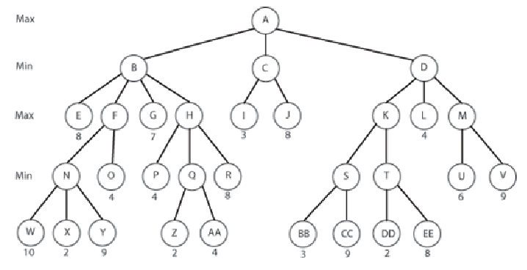
Alpha-Beta pruning rule
Stop expanding
max node n if α(n) > β higher in the tree
min node n if β(n) < α higher in the tree
= 4
β = 3
β = 3
β = 8
β = 4
= 4
= 8
= 3
= 2
= 4
β = 10
β = 2
β = 2
β = 2
β = 3
Which nodes will not be expanded when expanding from left to right?

Slide 49
Alpha-Beta pruning rule
Stop expanding
max node n if α(n) > β higher in the tree
min node n if β(n) < α higher in the tree
Which nodes will not be expanded when expanding from left to right?

Slide 50
Alpha-Beta pruning rule
Stop expanding
max node n if α(n) > β higher in the tree
min node n if β(n) < α higher in the tree
= 3
β = 8
β = 9
β = 7
β = 8
β = 4
β = 3
β = 3
= 8
= 2
= 9
= 3
= 4
β = 9
β = 4
β = 8
β = 2
β = 9
β = 2
β = 3
Which nodes will not be expanded when expanding from right to left?

Slide 51
Alpha-Beta pruning rule
Stop expanding
max node n if α(n) > β higher in the tree
min node n if β(n) < α higher in the tree
Which nodes will not be expanded when expanding from right to left?

Slide 52
3. Cut the search short
Use depth-limit and estimate utility for non-terminal nodes (evaluation function)
  Static board evaluation (SBE)
  Must be easy to compute
Example, chess:
Material balance = value of white pieces – value of black pieces, where
pawn = +1, knight & bishop = +3, rook = +5, queen = +9, king = ?
The parameters (α,β,γ,...) can be learned (adjusted) from
experience.

Slide 53
http://en.wikipedia.org/wiki/Computer_chess
Leaf evaluation
For most chess positions, computers cannot look ahead to all final possible positions. Instead, they must look ahead a few plies and then evaluate the final board position. The algorithm that evaluates final board positions is termed the "evaluation function", and these algorithms are often vastly different between different chess programs.
Nearly all evaluation functions evaluate positions in units and at the least consider material value. Thus, they will count up the amount of material on the board for each side (where a pawn is worth exactly 1 point, a knight is worth 3 points, a bishop is worth 3 points, a rook is worth 5 points and a queen is worth 9 points). The king is impossible to value since its loss causes the loss of the game. For the purposes of programming chess computers, however, it is often assigned a value of appr. 200 points.
Evaluation functions take many other factors into account, however, such as pawn structure, the fact that doubled bishops are usually worth more, centralized pieces are worth more, and so on. The protection of kings is usually considered, as well as the phase of the game (opening, middle or endgame).

Slide 54
Evaluation function
Here w_{i} are weighting factors and F_{i} are features (for position n), e.g. number of pawns, knights, control over central squares, etc.
Assumes independence (that features are additive and don’t interact)

Slide 55
4. Book moves
Build a database (look-up table) of endgames, openings, etc.
Use this instead of minimax when possible.

Slide 56
http://en.wikipedia.org/wiki/Computer_chess
Using endgame databases
…
Nalimov Endgame Tablebases, which use state-of-the-art compression techniques, require 7.05 GB of hard disk space for all five-piece endings. It is estimated that to cover all the six-piece endings will require at least 1 terabyte. Seven-piece tablebases are currently a long way off.
While Nalimov Endgame Tablebases handle en passant positions, they assume that castling is not possible. This is a minor flaw that is probably of interest only to endgame specialists.
More importantly, they do not take into account the fifty move rule. Nalimov Endgame Tablebases only store the shortest possible mate (by ply) for each position. However in certain rare positions, the stronger side cannot force win before running into the fifty move rule. A chess program that searches the database and obtains a value of mate in 85 will not be able to know in advance if such a position is actually a draw according to the fifty move rule, or if it is a win, because there will be a piece exchange or pawn move along the way. Various solutions including the addition of a "distance to zero" (DTZ) counter have been proposed to handle this problem, but none have been implemented yet.

Slide 57
5. Deep Fritz Chess
They employ a ”null move” strategy: MAX is allowed two moves (MIN does not move at all in between).
  If the evaluation function after these two steps is not high – then don’t search further along this path.
  Saves time (doesn’t generate any MIN move and cuts off many useless searches)

Slide 58
Reinforcement learning
A method to learn an evaluation function (e.g. For Chess: learn the weights w_{i}).
Reinforcement learning is about receiving feedback from the environment (occasionally) and updating the values when this happens.
Percepts
Sensors
REWARD
?
Environment
Agent
Actions
Effectors

Slide 59
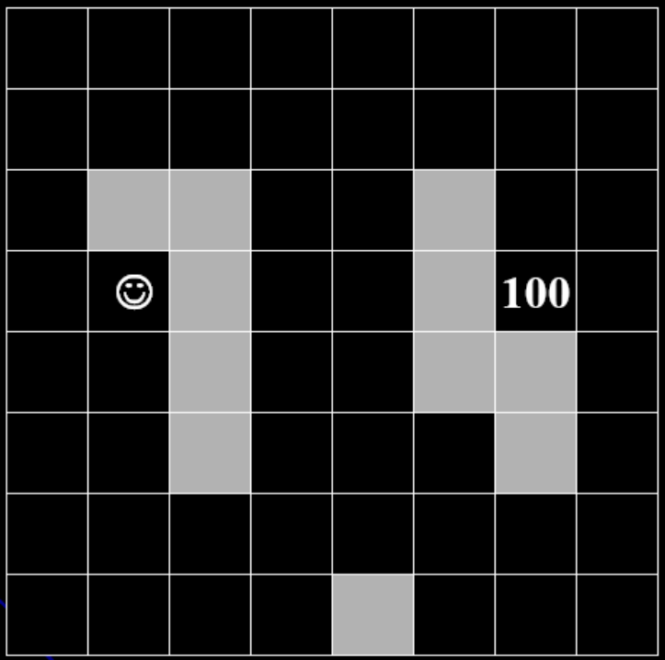
Reinforcement learning example
Robot learning to navigate in a maze
Goal node
Example borrowed from Matthias R. Brust, Univ. Luxemburg

Slide 60
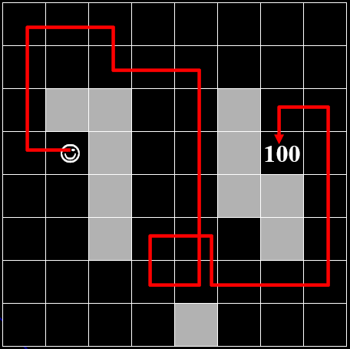
Reinforcement learning example
Robot learning to navigate in a maze
Generate a path at random and run until
the goal node is reached.
Example borrowed from Matthias R. Brust, Univ. Luxemburg

Slide 61
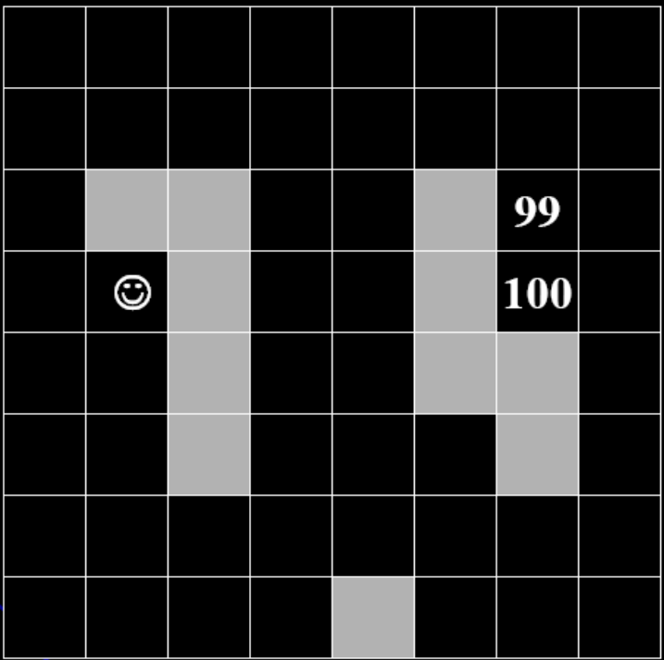
Reinforcement learning example
Robot learning to navigate in a maze
Assign a bit of the goal node’s utility value
to the next last square (the square just before
we reached the goal node).
Example borrowed from Matthias R. Brust, Univ. Luxemburg

Slide 62
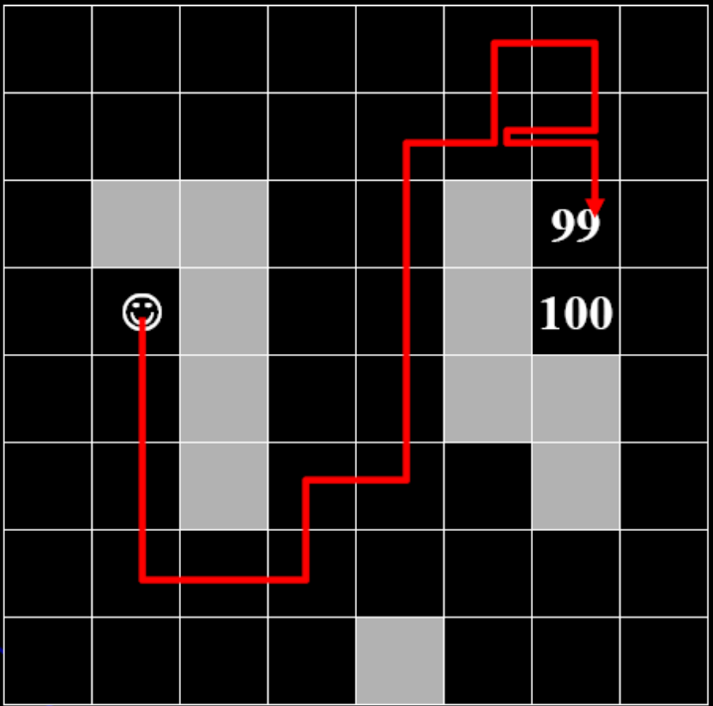
Reinforcement learning example
Robot learning to navigate in a maze
Generate a new random path and run
until a square with utility value is encountered.
Example borrowed from Matthias R. Brust, Univ. Luxemburg

Slide 63

Reinforcement learning example
Robot learning to navigate in a maze
Assign a bit of the utility value to the
next last square...etc.
Example borrowed from Matthias R. Brust, Univ. Luxemburg

Slide 64
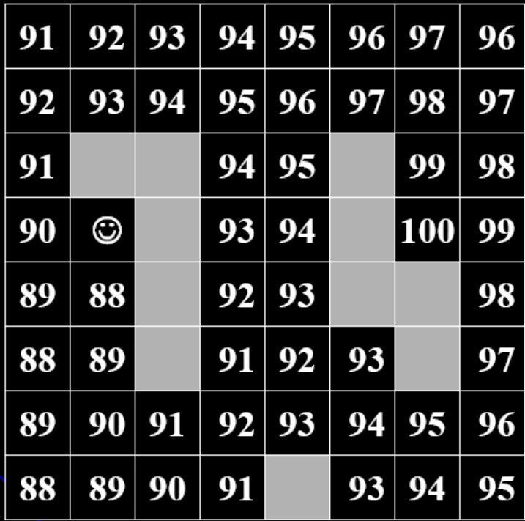
Reinforcement learning example
Robot learning to navigate in a maze
After some (a long) time do we have
utility estimates of all squares.
Example borrowed from Matthias R. Brust, Univ. Luxemburg

Slide 65
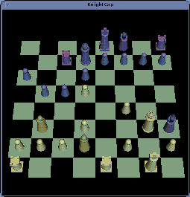
KnightCap (1997) http://samba.org/KnightCap/
Uses reinforcement learning to learn an evaluation function for Chess.
Initial values for pieces:
  1 for a pawn
  4 for a knight
  4 for a bishop
  6 for a rook
  12 for a queen
After self-learning:
  1 for a pawn
  3 for a knight
  3 for a bishop
  5 for a rook
  9 for a queen
Position (control, number of pieces attacking king) features crucial

Slide 66
Games with chance
Dice games, card games,...
Extend the minimax tree with chance layers.
A
α=
A
α=4
max
Compute the expected
value over outcomes.
50/50
50/50
4
50/50
50/50
-2
chance
.5
.5
.5
.5
Select move with
the highest
expected value.
B
β=2
C
β=6
D
β=0
E
β=-4
min
7
2
9
6
5
0
8
-4
Animation adapted from V. Pavlovic

